Slide 1

Indian Telecom Sector
Tushal Soni

Slide 2
agenda
Highlights last decade of telecom industry
Bharti Airtel & Reliance Jio revenue report analysis
Airtel Stock from 2016-2023
Indian Market Analysis
Business Strategies to create or capture established market

Slide 3



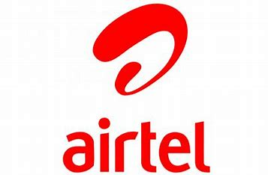




Highlights of Last Decade
Jio entered established market of telecommunication & gave tough competition to big sharks like: Airtel, Vodafone, Idea....
Repercussion of Reliance Jio entry in market:
& merge together to
is struggling to sustain in current telecom war of &
& vanished from market

Slide 4
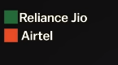
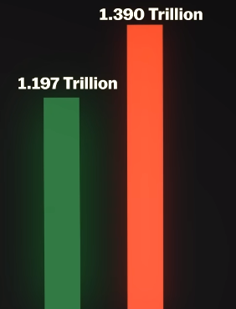
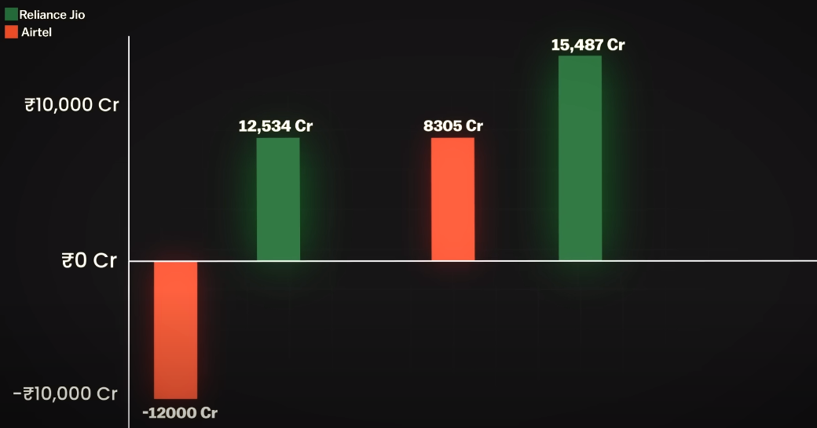
Bharti Airtel & Reliance Jio revenue report analysis
In FY21, Bharti Airtel 12000 Cr on other hand Reliance Jio 12,534 Cr
Bharti Airtel started generating profit by end of FY22
In ongoing FY 23, Bharti Airtel comeback with noticeable Reliance Jio
FY21 FY22 FY23

Slide 5
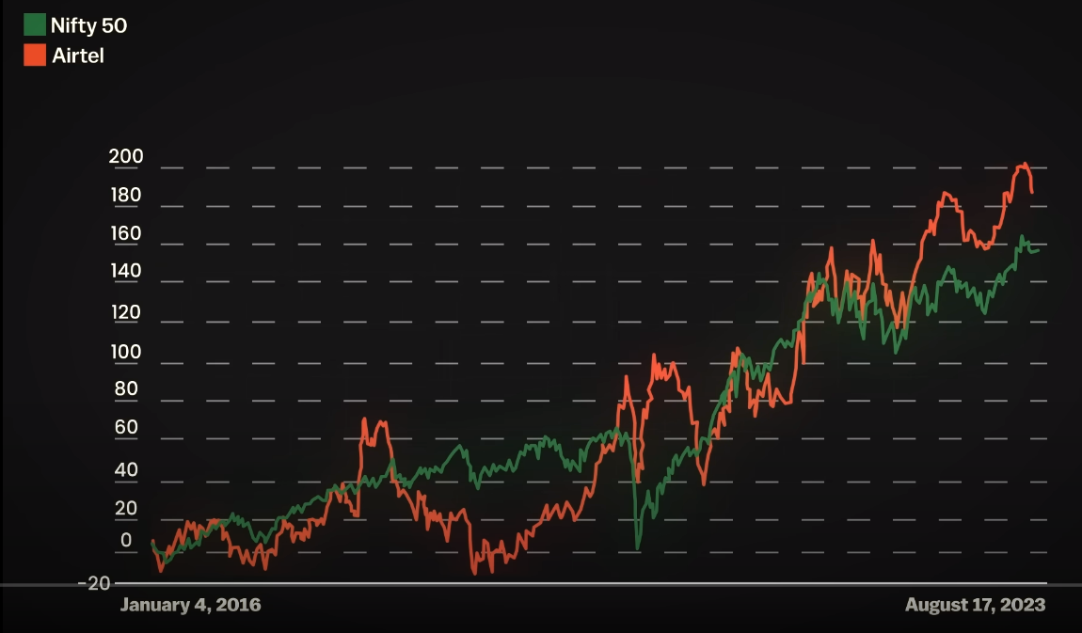
Airtel Stock from 2016-2023
Airtel Stock value faced a major hit after launch of Jio in 2016 but in last 6 quarter, stock value improved in comparison of Nifty 50 with health margin.

Slide 6


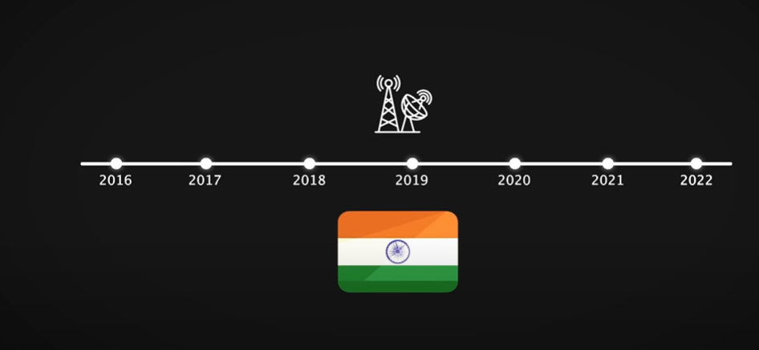
Indian Market Analysis

Slide 7
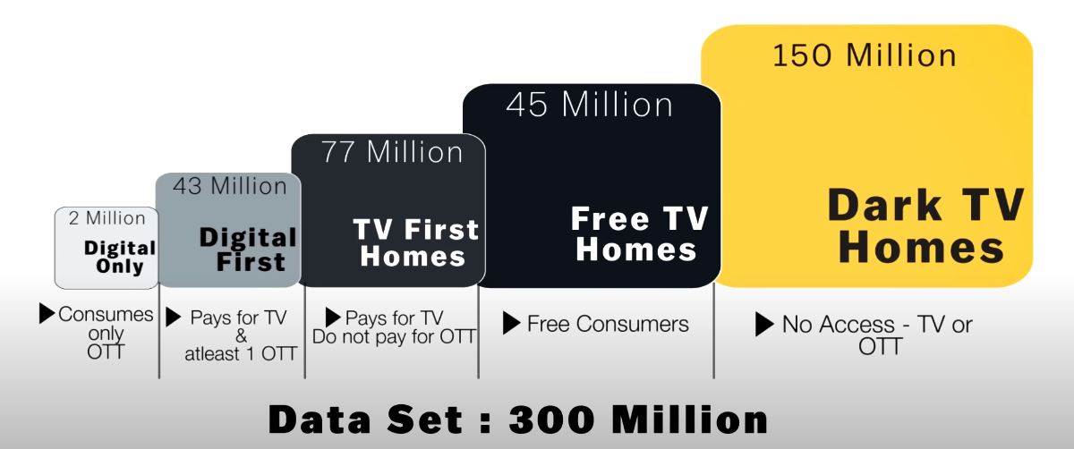
Indian Market can be categorised in five bins based upon two factors
Factors are accessibility of the technology & economy to afford it.
Categories are:
Dark TV Homes: Daily wagers
Free TV Homes: Lower-middle class
TV First Homes: Middle class
Digital First: Middle to upper class
Digital Only: Upper class & above
Indian Telecom Market Analysis Video Consumption Segment & market size
*KPM is thousands per month

Slide 8
Business Strategies to create or capture established market

Slide 9
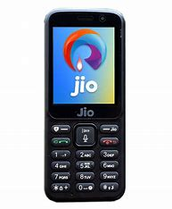
Average revenue per user (ARPU)
Fortune At Bottom OF Pyramid
In 2018 yr. end Airtel implemented a subscriber clean-up initiative & loose 49 million subscribers at bottom end
Increase minimum recharge of Rs. 99 to 155 in many tier 2 cities
Min recharge plan is 50% higher than Jio
JioBharat phone for lower class
4G feature phone
Generating revenue from adv. slots during IPL
By these two things Jio create market for itself also monetize it.

Slide 10
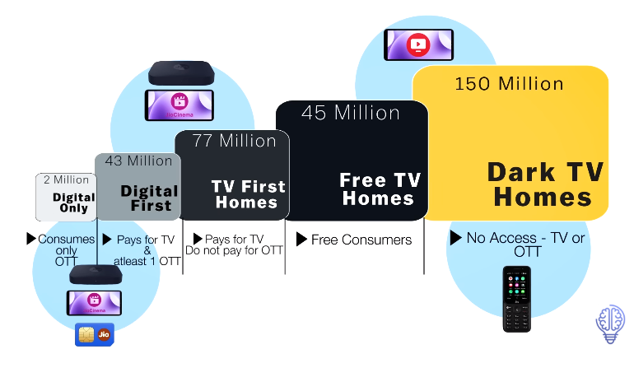
Reliance Jio
No Access-TV or OTT (150 million):
JioBharat feature phone which support 4G networking to market of 2G at reasonable price. Projection of 100 million new subscriber & Generating 5 Billion revenue in 4 yrs
Free Consumers & Pay for TV Do not Pay for OTT (123 million (45+ 77))
Jio has also targeted, customer segment by providing cheaper plans also adv. charge as they use JioCinema app without subscription
Pays for TV & Atleast 1 OTT ( 43 million ) & Consumers only OTT ( 2 million )
Jio has also touched market segment by providing subscription plans also affordable laptop
Jio Bharat feature phone

Slide 11
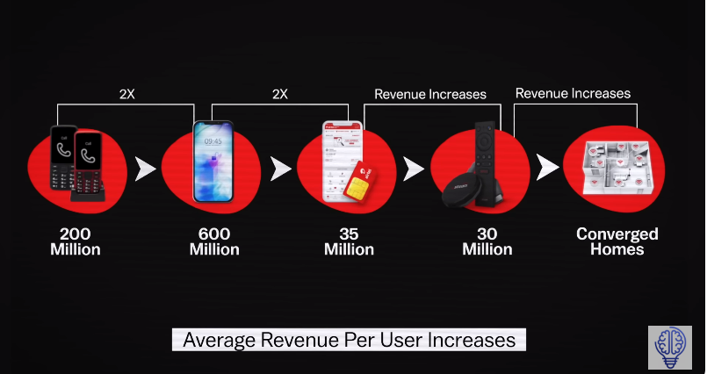
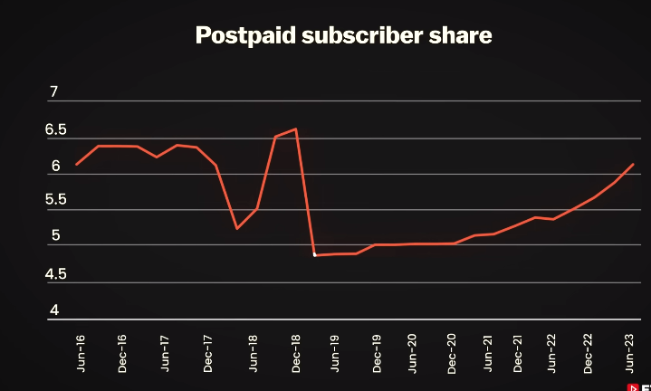

Bharti Airtel
No plan to launch feature phone or other segments of market
Capture premium customer by providing excellent service
Zero unfulfilled queries using AI interface build in collaboration with Nvidea
Prioritizing 700+ districts for high quality customer support
DTH connection 70-80% customer are of Airtel
Top to bottom approach can pay more for better user experience
Clean-up initiative in 2018-2019

Slide 12
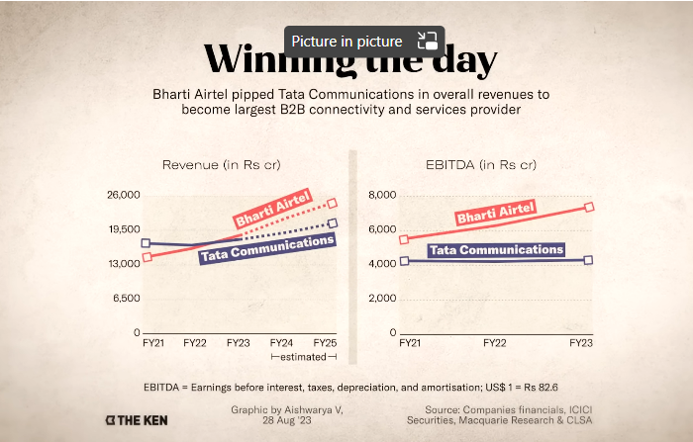
Airtel provide enterprise connectivity business
THE KEN (Indian Business News Website)
Airtel Business serves over 1200 global enterprises 2000 large, and a million small and medium business (SMBs) across India (भारत)
Is market leader with 33.67% of Revenue market share for the year end March 2023.

Slide 13
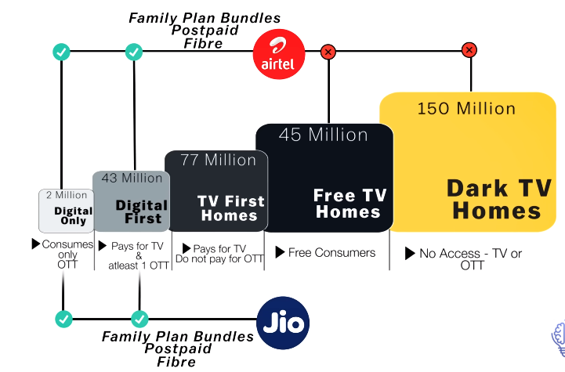
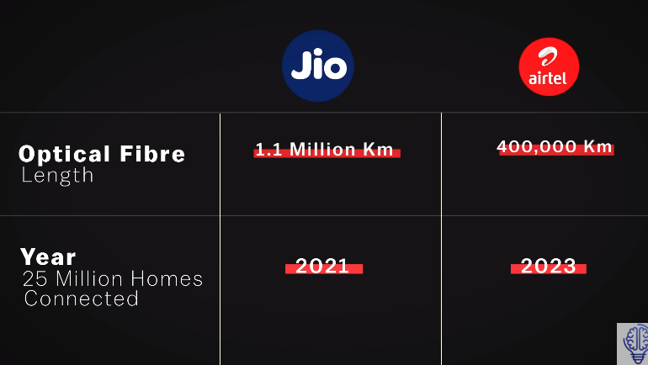
Telecom War btw Reliance Jio & Bharti Airtel
For Airtel post-paid audience is 6% but generate 25-30% of Revenue
Post-paid customer are charged 3X prepaid customer base but are active users
DTH connection 70-80% customer are of Airtel
Home broad band customer which give ARPU of 1000
Post-paid plan audience
Airtel 2 Sim for 599
Jio 2 sim for 499
Finance aid
prepaid to post-paid
Airtel Finance
Jio has no such department
Home broad band connection (Optical fibres)
Airtel spread 400,000 Km
Jio spread 1.1 million Km

Slide 14
Summary
Society beneficial initiatives like: Feature phones lower then market price, IPL broadcast free for users will generate market and you can also monetize them.
Eventually valuable customer will not only purchase a sim card or recharge but also complete package:
Post-paid or subscription plan ( Jio cinema app)
DTH connection
Broadband
Home broad band connection
Family plans
Users can be long term customers if they are getting excellent service.
Customer lifetime value at bottom of pyramid is far less for Airtel in comparison of JIO based upon my analysis.
At last, customer experience matters a lot

Slide 15


